Slide 1
Bibury parking working group – ACTION PLAN UPDATE
Short, Medium & Long-Term resolutions
to parking and traffic issues in Bibury
Issue 2 - June 18th 2024

Slide 2
INDEX
Executive Summary - 3 and 4
Examples of Issues - 5 to 7
Objectives - 8
Action Plan Summary – 9
Traffic Regulation Order (TRO) – 10 to 12
Enforcement – 13 to 15
Weight limits – 16 to 19
Engagement - 20 to 23
Signage – 24 to 26
Parking – 27 to 31
Other Considerations – 32 and 33

Slide 3
Who has compiled this plan?
This plan was put together by the Bibury Parking Working Group (‘BPWG’) in response to a request for assistance from the Bibury Parish Council and published June 4th 2024.
Significant progress in first two weeks of June 2024.
The BPWG are volunteers who recognise the impact of parking issues in the village and want to provide a robust, long-term solution. The plan is a framework that all residents and local stakeholders can contribute to.
Chair BPWG Mark Honeyball mark_honeyball@yahoo.co.uk
Chairman BPC Craig Chapman craigchapman@biburyparishcouncil.gov.uk
Cllr BPC Brian Skarda brianskarda@biburyparishcouncil.gov.uk
District Cllr David Fowles
Cllr Bourton PC Madan Samuel

Slide 4
EXECUTIVE SUMMARY
WHAT IS THE ISSUE?
Bibury is a small, residential village. It is a beautiful village that attracts visitors. For clarity, “Bibury” includes Arlington.
Over the last 5-10 years the level of visitors has increased exponentially.
There has been a huge increase in the number of cars and coaches visiting the village. There is a lack of infrastructure and parking control to support the increased levels of tourism. Further, there are a limited number of commercial activities and these indicate that they see limited income from the coach passengers (this is a major difference between Bibury and Bourton).
The additional tourism is having a detrimental effect on the fabric and essence of the village. What was a quintessential, peaceful and idyllic rural village has become an overcrowded haven. Roads, verges, the Swan Bridge and property are being damaged by coaches and cars. Residents are becoming increasingly frustrated and annoyed at not being able to enjoy their homes and village in peace. At times they cannot drive around the village or walk on the pavements due to tourist volumes and illegally parked vehicles.
The County Council, District Council, Coach Companies and Police need to understand the impact and put measures in place to remedy the situation urgently and this plan seeks to provide solutions and a mechanism to ensure that they do so in the best interests of our village and community.

Slide 5
EXECUTIVE SUMMARY
CONSIDERATIONS
CAUSES |  | IMPACTS
Increased private car traffic from tourists since Covid/Lockdown |  | Increased congestion
Increased number of Buses and Mini-vans visiting Bibury |  | Restriction of emergency vehicle access
Lack of Parking Availability |  | Cars parked illegally and obstructing highways and pavements
Lack of Parking Control |  | Damage to the bridge, walls, bollards and coach-bays
Lack of Parking Enforcement |  | Frustration of residents
Lack on controls to manage overweight vehicles |  | Obstruction on pavements for mobility vehicles and prams
Increased Attractions (Trout Farm expansion) |  | Increased likelihood of serious injury, incident or fatality
Inadequate Signage

Slide 6
OBJECTIVES
WHAT DO WE WANT TO ACHIEVE?
Realistically we aren’t going to stop tourism or through-traffic in the village but we must manage it – for the mutual benefit of residents, local businesses, the fabric of the village, local ecology, the tourists and tourism companies.
The benefits relating to the residents, fabric of village and ecology should override those of local businesses and those of tourists and certainly those of tourism companies.
What we wish to achieve:
Allow Residents to reclaim and enjoy their homes and their village safely, without excessive intrusion from tourists.
Maintain the fabric and quintessential nature of the village and it’s ecology, preventing physical damage (e.g., bridge, roads, walls around meadow, river walls) and damage to wildlife
Effectively manage parking so that the village and residents are not impacted whilst allowing tourists to experience the village and what it has to offer in a non-invasive manner.
Primary objectives:
A total ban on any vehicles (coaches or heavy goods vehicles) over 17T (laden) crossing the Swan Bridge.
A total ban on coaches in and through the village.
Converting current coach bay to car use only or pedestrianise.
Creation of additional parking and more effective management/enforcement of existing parking.

Slide 7
ACTION PLAN SUMMARY
Complete |  | In Progress |  | Not Started
 | SOLUTIONS
SHORT-TERM | SHORT-TERM | Who | When |  | SHORT-TERM | SHORT-TERM | Who | When |  | LONG-TERM | LONG-TERM | When
1 | Obtain Highways survey results for bridge – structural damage? Damage found and to be repaired | BPC | June 2024 |  | 11 | Signage - Review Weight Limit and Prohibition / Parking Signage (improve to Trout Farm carparks – some implemented) | BPC / BPWG | June 2024 |  | 19 | Discuss MTE with GCC and Highways – meeting being arranged with GCC | Jun / Jul 2024
2 | Implementation of Phase 1 TRO– confirmed for w/c 24 June (weather permitting) | BPC | w/c 24 June |  | 12 | Work with Trout Farm to ensure safe use of existing parking (establish pathway) | BPC | June 2024 |  | 20 | Dedicated Tourism / Visitor car park for cars if viable and required | 2025
3 | Agree level of officer enforcement of TRO / parking restrictions – implement post TRO evaluation | BPC / BPWG | Q3 2024 |  | 13 | Agree use of additional land for car-parking Tout Farm and obtain progress from Swan Hotel | BPC | June/ Jul 2024 |  | 21 | Amenities at car park (refreshments, toilets, shuttle for disabled and elderly) | 2025
4 | Progress Phase 2 TRO for ANPR at Swan Bridge and for conversation of Carpark opposite Trout Farm to cars only | BPC | Q2 2024 |  | 14 | Identify land suitable for parking cars on periphery of Bibury if required. Coaches not identified | BPC / BPWG | From Jun ‘24 |  | 22 | Residents only parking / access to village by vehicle | 2025
5 | Agree TRO / Start enforcement of Overweight traffic using bridge by ANPR | BPC | Q3 / 4 2024 |  | MID-TERM | MID-TERM | Who | When
6 | Establish list of coaches / companies and their laden weights – list of 53 established and all weights identified | BPC / BPWG | June 24 |  | 15 | Engagement with Coach Operators to agree code of conduct and agree solutions. Letters going to all 53 w/c 17th June | BPWG | Q3 2024
7 | Build on engagement to date with Glous. County & District Council / Highways / Parking / Councillors / Police / MP / Media / Journalists & Social Media | BPC / BPWG | Started- ongoing |  | 16 | Engage Private Contractors to enforce parking – evaluate post TRO implementation and further talks with GCC | BPC | From Q4 2024
8 | Engagement with residents / businesses / PCC / National Trust / Coach Companies and drivers | BPC / BPWG | June / July / 2024 |  | 17 | Restrict all overweight vehicles over bridge through village (lower bridge weight limit?) incl. coaches (currently exempt) – progressing with GCC | BPC | Q3 2024
10 | Proposal to substantially reduce weight limit and enforce being discussed with GCC | BPC / BPWG | June 2024 |  | 18 | Liaise with other similar villages to understand solutions – initiated with Bourton | BPC / BPWG | From Q3 ‘24

Slide 8
TrafFic REGULATION ORDER (tro)
The TRO is a legal order, which allows the highway authority to regulate the speed, movement and parking of vehicles

Slide 9
1. TRO
TRO
STRENGTHS
Immediate restriction of places vehicles can park
WEAKNESSES
Requires regular enforcement to be effective
OPPORTUNITIES
Revenue generation to cover enforcement and further improvements
THREATS
Relocates issues to other parts of village
Restricts resident, business and event parking
w/c 24th June Implementation.
Funded by enforcement
Funding for dedicated parking areas?
Parking permits?
Dedicated parking areas?

Slide 10
TRO
Following 3 phases of consultation the existing (Phase 1) TRO was signed off in August 2023. To be implemented w/c 24th June 2024 weather permitting by Ringway.
NOTE: Currently visitors (foreign and domestic) are ignoring yellow lines and are seeing no / limited enforcement. Adequate enforcement will manage this on the day but needs to be constant / more regular. Current lines are worn away and in the interim cones have been applied to prevent illegal parking, but this is only a temporary expedient.
Review provisions for resident parking at school/village hall? Resident permits?
Actions | Status | By Who | By When | Notes
Confirm date for implementation of TRO with GCC / implement | In progress | BPC | June 2024 / Q2 ’24 Short Term | Confirmed w/c 24th June 2024 weather permitting by Ringway
Progress Phase 2 TRO for ANPR at Swan Bridge and conversion of carpark opposite Trout Farm to cars only | In progress | BPC | Q2 2024 Short Term | TRO required to gain community approval for weight monitoring and change carpark
Agree TRO for ANPR at Swan Bridge / carpark conversion | Not Started | BPC | Q3/4 2024 Short Term
Review Resident Permits | Not started | BPC | 2025 Long Term | Need to establish viability and costs

Slide 11
enforcement

Slide 12
2. ENFORCEMENT
ENFORCEMENT
STRENGTHS
Immediate fines or moving on of vehicles in contravention of current or future restrictions
WEAKNESSES
Requires constant resourcing. Only effective for current visitors not future/ongoing
OPPORTUNITIES
Revenue generation to cover enforcement and further improvements
THREATS
County Council not adequately enforcing. Lack of funding
Immediate action required…but why should Parish pay! Recharge?
Funded by enforcement
Funding for dedicated parking areas?
Private Enforcement by Parish Council
Divert funding to Parish Council

Slide 13
ENFORCEMENT
Some limited enforcement but this is only dealing with the issue at a specific point-in-time. Gloucestershire County Council or Police should be more regularly and systematically enforcing parking in Bibury. It is revenue generating and will help stop anti-social / illegal parking. Unlikely that we will get much more than token enforcement as GCC and Police under resourced and under-funded.
Alternative is to engage with Private Parking Enforcement. Cost is c.£22 per hour. This could be self-funding and revenue generating to help repair village and provide amenities.
Is there an ability to allow residents to send in photos for Police / Private enforcement to raise penalties?
Actions | Status | By Who | By When | Notes
Confirm what enforcement will be provided by GCC and Police - set minimum / guaranteed levels - implement | In progress | BPC | Q2 / 3 2024 Short Term | To be assessed post TRO implementation – Police, NSL
ANPR at Swan Bridge | Not started | BPC | Q3/4 2024 Short Term | ANPR so that enforcement can be implemented / fines issued
Engage Private Contractors to enforce parking | Not Started | BPC | From Q4 2024 Medium Term | Quotes obtained. Establish if GCC will fund – or fund locally from precept.
Investigate Resident Reporting | Not started | BPC | 2025 Long Term | Discuss with GCC, Police and Private Enforcement

Slide 14
Weight limits

Slide 15
3, 4, 10, and 11. WEIGHT RESTRICTIONS
WEIGHT LIMIT
STRENGTHS
Stops overweight vehicles using Swan Bridge
WEAKNESSES
Limited to 17T. PSV’s exempt
OPPORTUNITIES
Request Weak Bridge/Weight Reduction
THREATS
Bridge has damage and as do bays and walls around them
Bridge survey indicates damage. Review 7.5T weight limit
7.5T limit being reviewed. How do we enforce?
Encouraging discussions with GCC in progress
GCC repairing bridge

Slide 16
WEIGHT LIMITS
Weight Limit currently 17T. PSV (Passenger Service Vehicles) exempt!
Damage to the Swan bridge has been indentified from a survey undertaken in May 2024 and to parking bays/walls
ANPR survey results:
Conducted over 2 weeks in Jan/Feb 2024
61 vehicles weighing in excess of 18T
Proposed continuation of ANPR to prosecute offenders
33,610 cars, 4970 LGV, 555 OGV1, 61 OGV2, 360 PSV (low season figures)
NOTE: ANPR measures unladen weight. We need to establish list of coaches’ laden and unladen weights for those that we know frequent the village.

Slide 17
WEIGHT LIMITS (contd.)
Weight Limit currently 17T. Potential to reduce to 7.5T (including coaches)
PSV (Passenger Service Vehicles – coaches / buses) currently exempt!
Actions | Status | By Who | By When | Notes
Highways survey results for bridge | Report awaited. Initial conclusion received. To be repaired. | BPC | May 2024 Short Term | Discussions being had with GCC to reduce weight to 7.5T (exemptions for local service and agricultural)
Establish list of coaches and their laden weights | Complete | BPWG | From May 2024 Short Term | List compiled. Communications being sent to each w/c 17 June
1) Make urgent request for Weak Bridge, 2) Apply weight limit to all vehicles incl. PSV’s once survey results known | In progress with GCC | BPC | 1) June 2024 - if damaged 2) Q4 2024 Short / Med. Term | Awaiting date for meeting with all stakeholders. GCC being pro-active.

Slide 18
engagement

Slide 19
5 - 9 ENGAGEMENT WITH STAKEHOLDERS
ENGAGEMENT
STRENGTHS
Allows us to use the evidence collated to make stakeholders aware of issues and what we expect to be done
WEAKNESSES
Lots of stakeholders in County Council / Highways who need to co-ordinate
Lack of funding
OPPORTUNITIES
Places accountability with appropriate stakeholders. Hold to account
THREATS
Election – changes of Elected Influencers
Lots of Stakeholders to be contacted and co-ordinated. Awareness is key
Part funded by Parish precept? Why? Other funding?
Place accountability and expectations. Use election for additional impetus
Changes of elected stakeholders – re-engagement required?

Slide 20
ENGAGEMENT
The BPC and BPWG can only do so much. Stakeholder engagement will be vital to making this succeed. It must be consistent and build the case (using logic, not anger - however hard this may be)
All residents can have a voice and take action. The louder we shout, the more we will achieve – TOGETHER.
We have to put pressure on, and influence key stakeholders. They are the accountable action owners.

Slide 21
ENGAGEMENT
Actions | Status | By Who | By When | Notes
GCC Highways | Engaged | BPC/BPWG | Ongoing | Implement TRO, action enforcement of TRO (or fund private?), bridge weight limit and inclusion of PSV’s, discuss other initiatives (e.g.MTE)
CDC | Engaged | BPC | Ongoing | Limited involvement. Informed
Gloucestershire Police | Engaged | BPC/ BPWG | Ongoing | Police on board, supported by Cllr Spivey. However, funding, resource and powers are limited. Re-engage on enforcement and presence.. Support for impact on emergency vehicles as part of weight limit and MTE initiatives
Police Commissioner | In progress | BPC/ BPWG | Ongoing | Engaged but little co-operation – utilise media strategy to put on pressure
Coach Companies & drivers | In progress | BPWG/ Residents/ Local businesses | June/July 2024 | List of 53 coach companies identified. Writing letter explaining impact to village, safety and bridge to all directors w/c 17 June 24
MP | Engaged | BPWG | June 2024 | Sir Geoffrey Clifton-Brown to put pressure on authorities in June
Media & Social Media | Engaged | BPWG | Ongoing | Some BBC coverage. Engaged journalist/s. Always need more (+social) Agree messaging – change behaviours and awareness/pressure on Authorities. Spectator to publish article
National Trust | In progress | BPC/ BPWG | June 2024 | Part of attraction in Arlington Row. Can they help fund solutions/provide resource? Discuss with Sherbourne office and HQ
Local Businesses | In progress | BPC/ BPWH | Ongoing | Media interviews, survey opinions and impacts. Trout Farm, The Swan, Catherine Wheel, The Twig, Nicks Ice Cream
Residents | In progress | BPWG | June 2024 | Share draft plan for comments. Potential Survey/media interviews. Create templates for notices on put on cars/letters to coach operators. Potential for demonstrations with Police and Media attendance?

Slide 22
signage

Slide 23
12. SIGNAGE
SIGNAGE
STRENGTHS
Directs traffic to allocated parking
Re-enforces weight-restriction and no-parking areas
WEAKNESSES
Often Ignored
Makes village look untidy
OPPORTUNITIES
ANPR, Resident Reporting
Fines to fund improvements
THREATS
Election – changes of Elected Influencers
Lack of funding
Cost for signage to be co-funded by Highways, Parish, Trout Farm?
Constant/ regular enforcement required
Ability to report illegal parking to Police/Parking enforcement for tickets to be raised
Changes of elected stakeholders – re-engagement required?

Slide 24
SIGNAGE
Current signage insufficient in village and on approaching roads for weight limit and parking (for example to the two Trout Farm carparks). If weight-limit can be reduced following bridge damage survey, and to include PSV’s, additional signage may need to be placed on A40/B4425 junction at Burford and at Cirencester end to make coaches and HGV’s aware of weak bridge and new weight limit. Hopefully to prohibit HGV’s and PSV’s.
As new TRO is implemented and new car/coach parking, signage will need to be updated approaching and within village. It will need to be prominent and directional to the appropriate parking area.
Suggest we also place “no pedestrian” signage at either side of Swan Bridge
Actions | Status | By Who | By When | Notes
Review Weight Limit and Prohibition signage | In progress | BPC | June 2024 Short Term | Survey shows damage. To be repaired. 7.5T weight limit being discussed
Review / address Parking Signage | In progress | BPC | June 2024 Short Term | Initial signage up. Additional signage following TRO implementation

Slide 25
parking

Slide 26
13, 14, 15, 16 PARKING
PARKING
STRENGTHS
Dedicated areas for car and coach parking outside village centre
Maintains essence of village
OPPORTUNITIES
Revenue stream for owner of car and coach parks
Additional revenue/jobs for shuttle, coffee bar etc?
THREATS
Lack of land, funding.
Long Term solution
WEAKNESSES
Huge cost to acquire land and change use
Safe pedestrian access to village from coach park
Trout Farm land for cars. Land for coaches to be identified
Does anyone have land? Know of land we can use for coaches? Who funds?
Could we partly fund through enforcement in village (long term)
Changes of elected stakeholders – re-engagement required?

Slide 27
PARKING
There is a lack of parking for the increasing level of tourists (both cars and coaches). The TRO will restrict parking further (if enforced) so additional parking is required.
CARS
There is space for 195 to 225 cars on land owned by the Trout Farm. Gravelled and Overflow Carparks with machines to manage parking. Pedestrian walkway needs to be established from car park to Trout Farm. Signage to be put up. Parking will be chargeable. Revenue source for Trout Farm (subsidy to BPC to cover costs?)
There is further land owned by the Trout Farm that could also be changed to parking use and will provide a further 150 spaces. This needs approval and co-ordination between BPC, Highways and the Trout Farm to action. Also, The Swan Hotel has planning approval for a carpark which is not being progressed
Actions | Status | By Who | By When | Notes
Work with Trout Farm to ensure safe use of existing parking | In progress | BPC | June 2024 Short Term | Requires pedestrian walkway to be agreed and implemented by Trout Farm
Agree use of additional land for car-parking | In progress | BPC | Jun / Jul 2024 Short | By Trout Farm and Swan Hotel

Slide 28
PARKING - COACHES
The centre of the village is not suitable for safe coach parking/turning. The bridge is being damaged. Traffic is being severely congested. Residents, Tourists and coach drivers are finding this untenable. There is no co-ordination between the coach companies as to when they visit. Coach bays to be converted to cars only/pedestrianised.
Coaches must be prevented from crossing the bridge and parking/dropping off in the village.
As part of a Due Diligence exercise opportunities for coach parking on the periphery of Bibury have been evaluated, in a similar model to those implemented at Castle Combe, Lindisfarne, Craster and Laycock, whilst none have been identified
Land of the periphery of Bibury needs to be identified, procured and made suitable. Opportunity for revenue and jobs for local residents (e.g. coffee stall, shuttle bus) – if viable.
Actions | Status | By Who | By When | Notes
Identify land suitable for cars) on periphery of Bibury | Initial discussions in progress | BPC | From June 2024 Short Term | Consult local residents, landowners and businesses to identify and procure land
Approach coach companies to obtain co-ordination of visits | Not started | BPC / BPWG | Q3 2024 Medium Term | 53 companies identified. Awaiting response to initial letters and weight limit restrictions before commencing
Liaise with other similar villages to understand solutions | In progress | BPC/ BPWG | Ongoing Short / Med Term | Initial contact with Bourton instigated. Northumberland County Council very proactive and consistent on this matter.

Slide 29
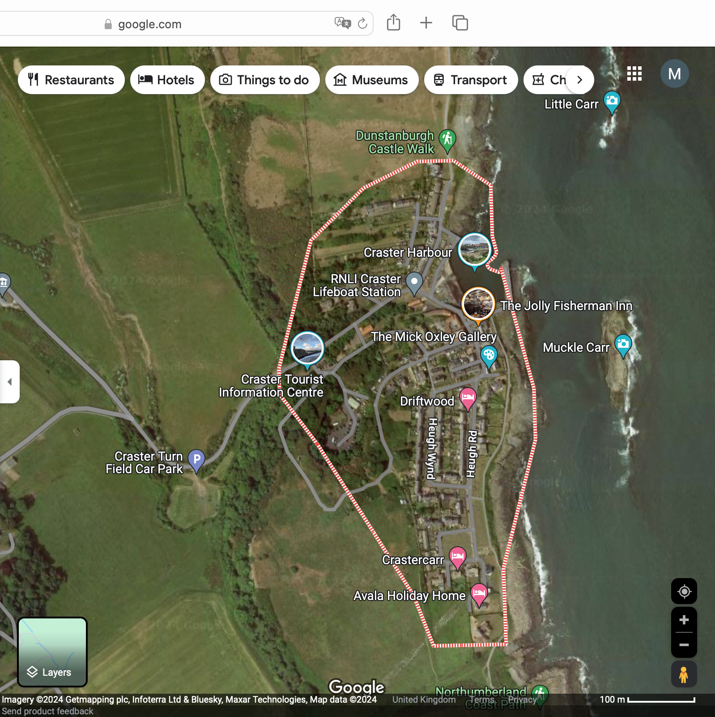
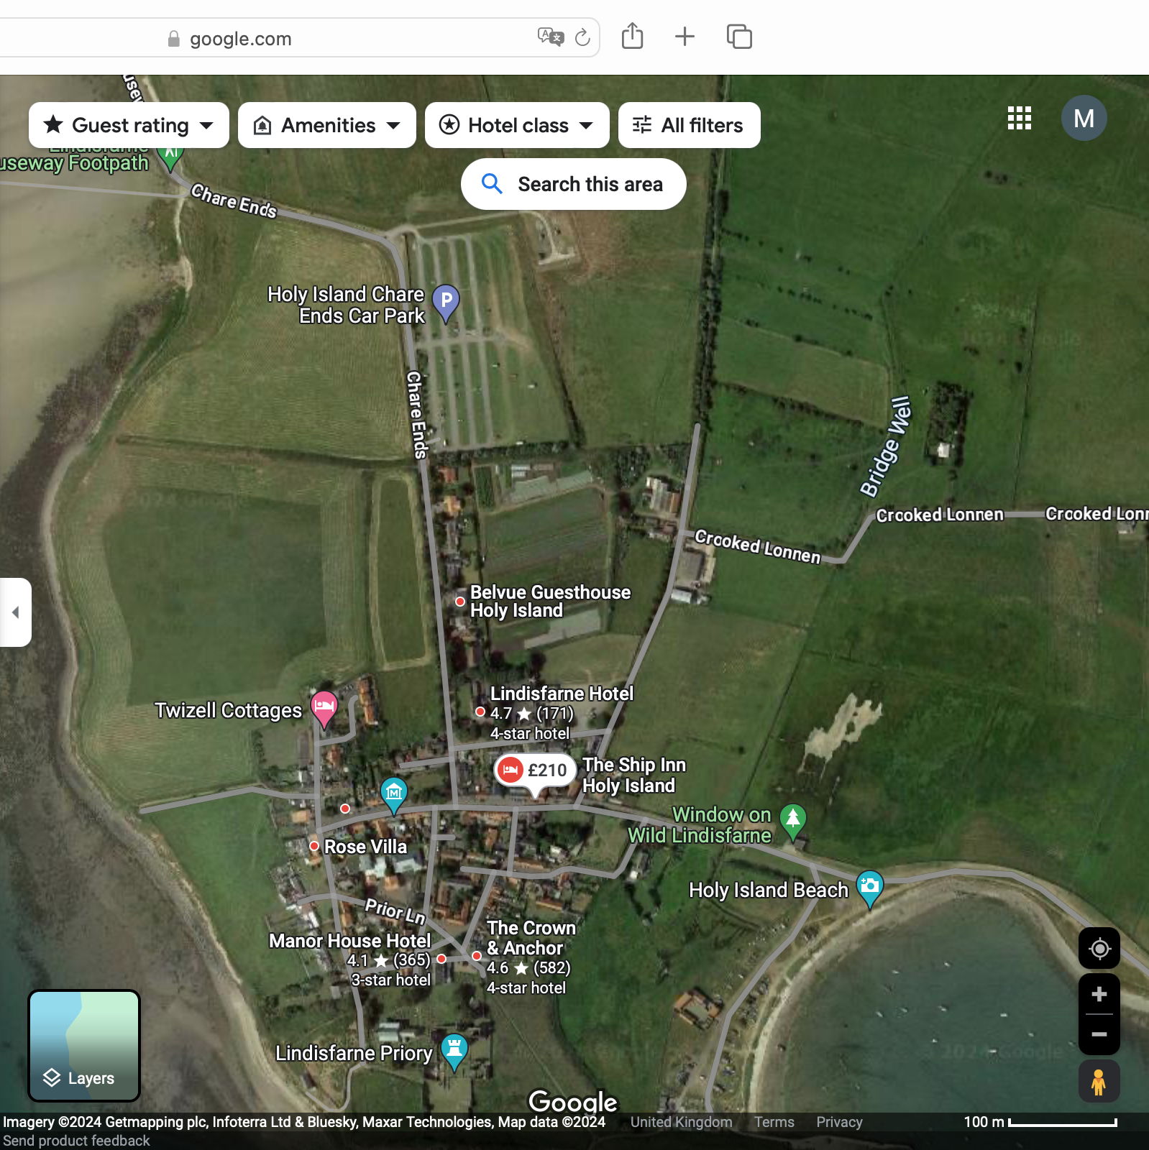
LONGER-TERM SOLUTIONS – HOW DOES IT WORK ELSEWHERE?
Craster, Northumberland
Castle Combe, Wiltshire
Lindisfarne, Northumberland
Restriction of tourist vehicles (coaches and cars) to villages
Car Parks owned and managed by Northumberland County Council (Craster and Lindisfarne).
Revenue generation for County Council or owner of land (e.g. Trout Farm)
Signage explaining that residents and village should be respected.

Slide 30
Other considerations

Slide 31
ADDITIONAL CONSIDERATIONS
Moving Traffic Initiative (Gloucestershire County Council)
https://www.gloucestershire.gov.uk/parking/moving-traffic-enforcement-information/
An enforceable initiative to keep traffic moving and avoid congestion.
Cllr Dave Norman, cabinet member for road safety, said: “The majority of road users travel safely and follow the traffic regulations, however a small number do not, which causes a potential safety issue for everyone.
“Enforcing offences in these locations will act as a deterrent to people who are tempted to break the rules, which will help to prevent collisions. These measures will make our roads safer and keep traffic flowing, as well as encourage walking and cycling and promote the use of public transport.”
Actions | Status | By Who | By When | Notes
Discuss MTE with GCC and Highways | Not started | BPC/ BPWG | Jun / Jul 2024 Short Term | Funding available for this initiative?

